Slide 1
Turbine Fire
Data Report
- Abirami.V

Slide 2
Without KFold
With KFold
Training data: 1016
Validation data: 400
Total: 1416
Training data: 1133
Validation data: 283
Total: 1416
Test data: 200

Slide 3
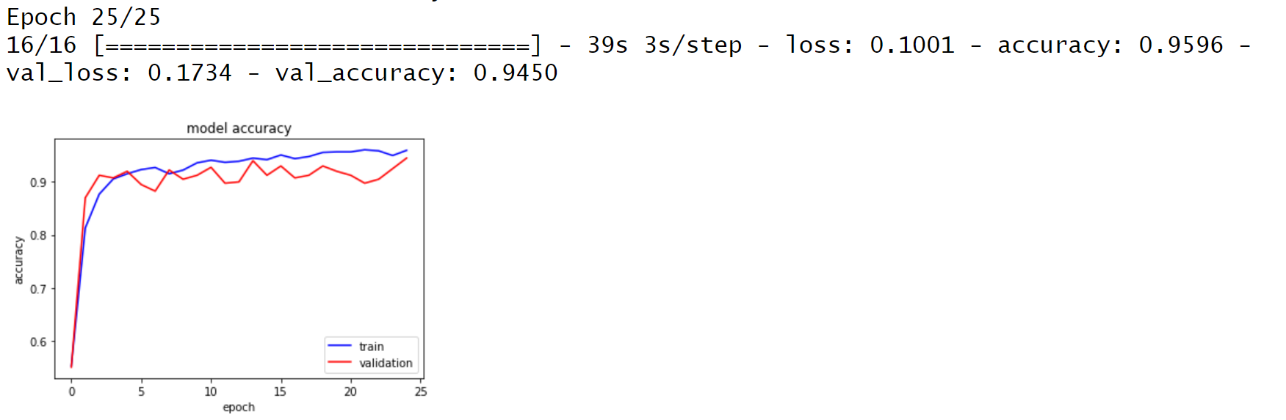
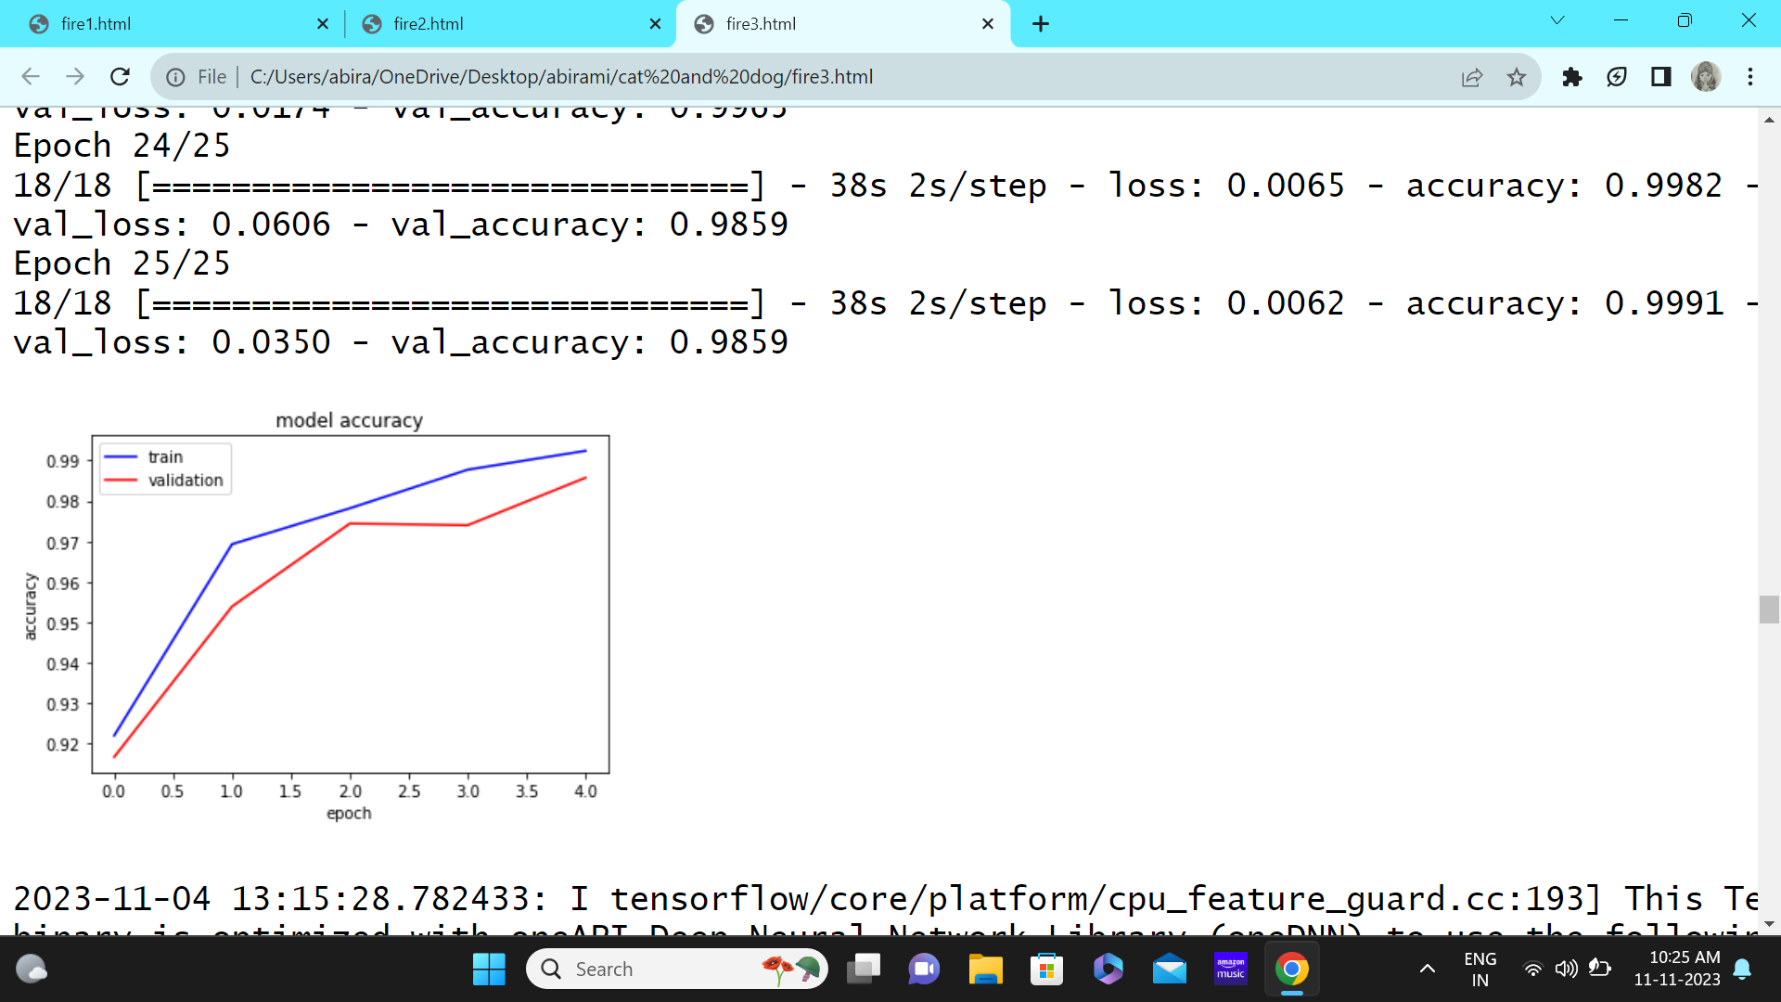
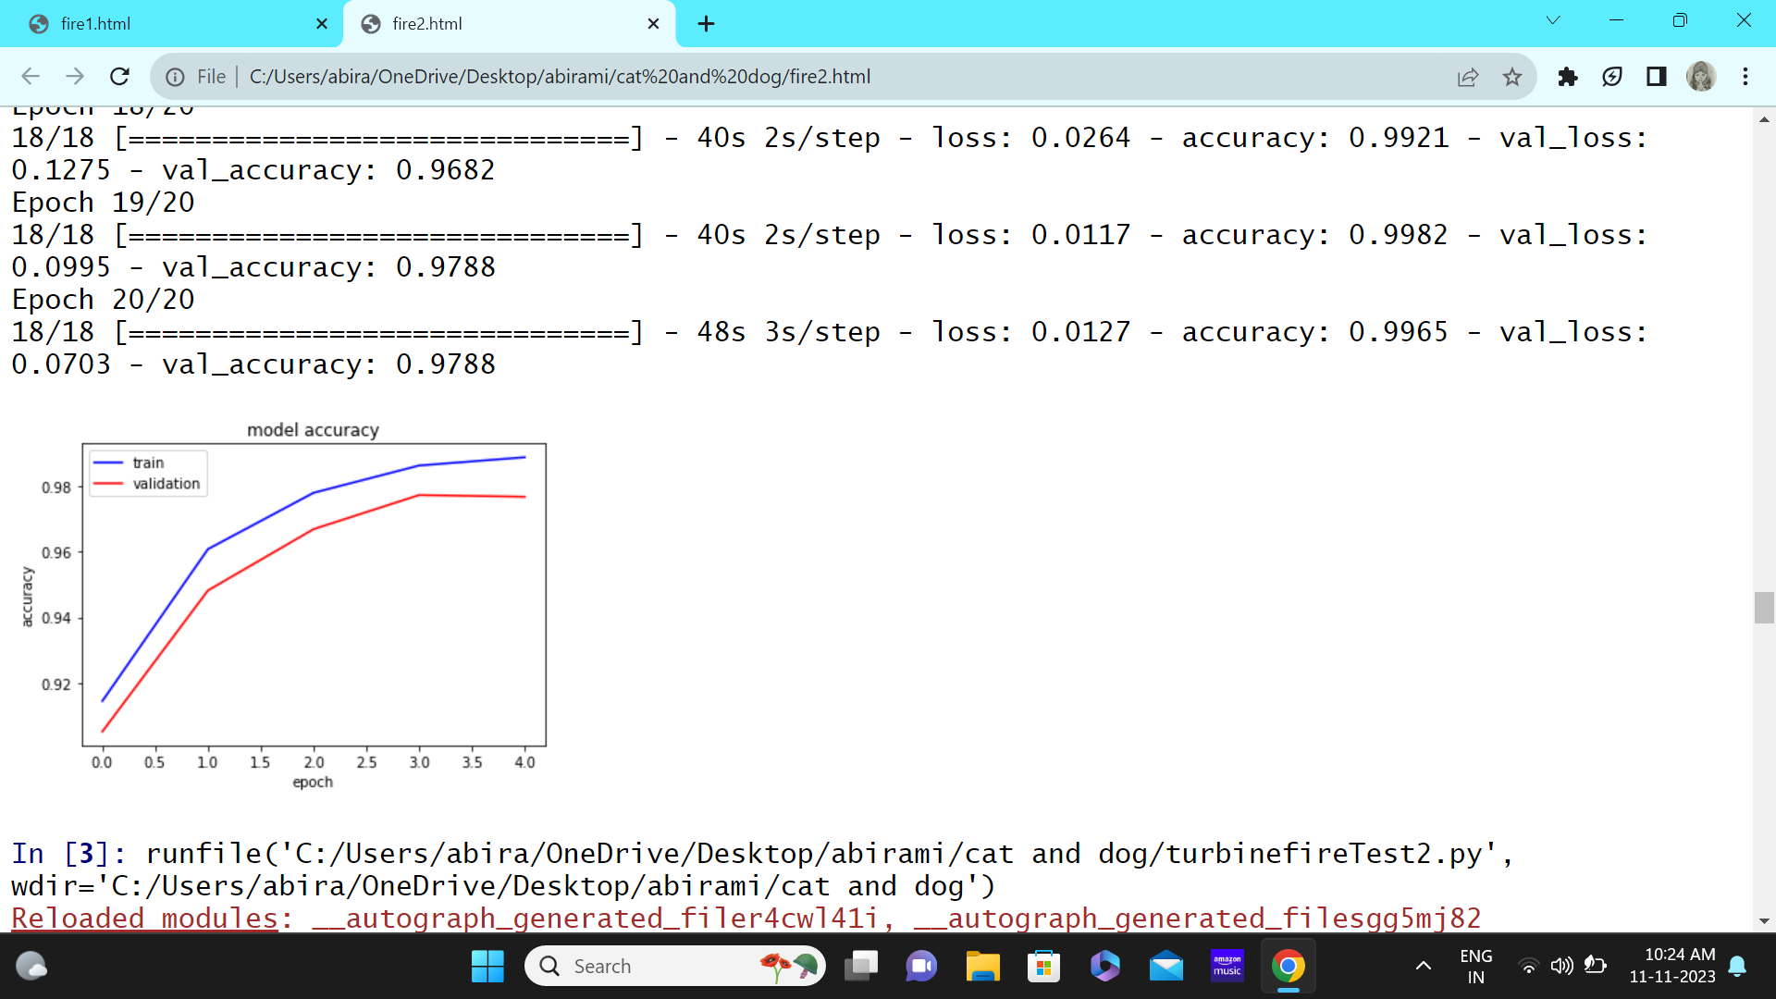
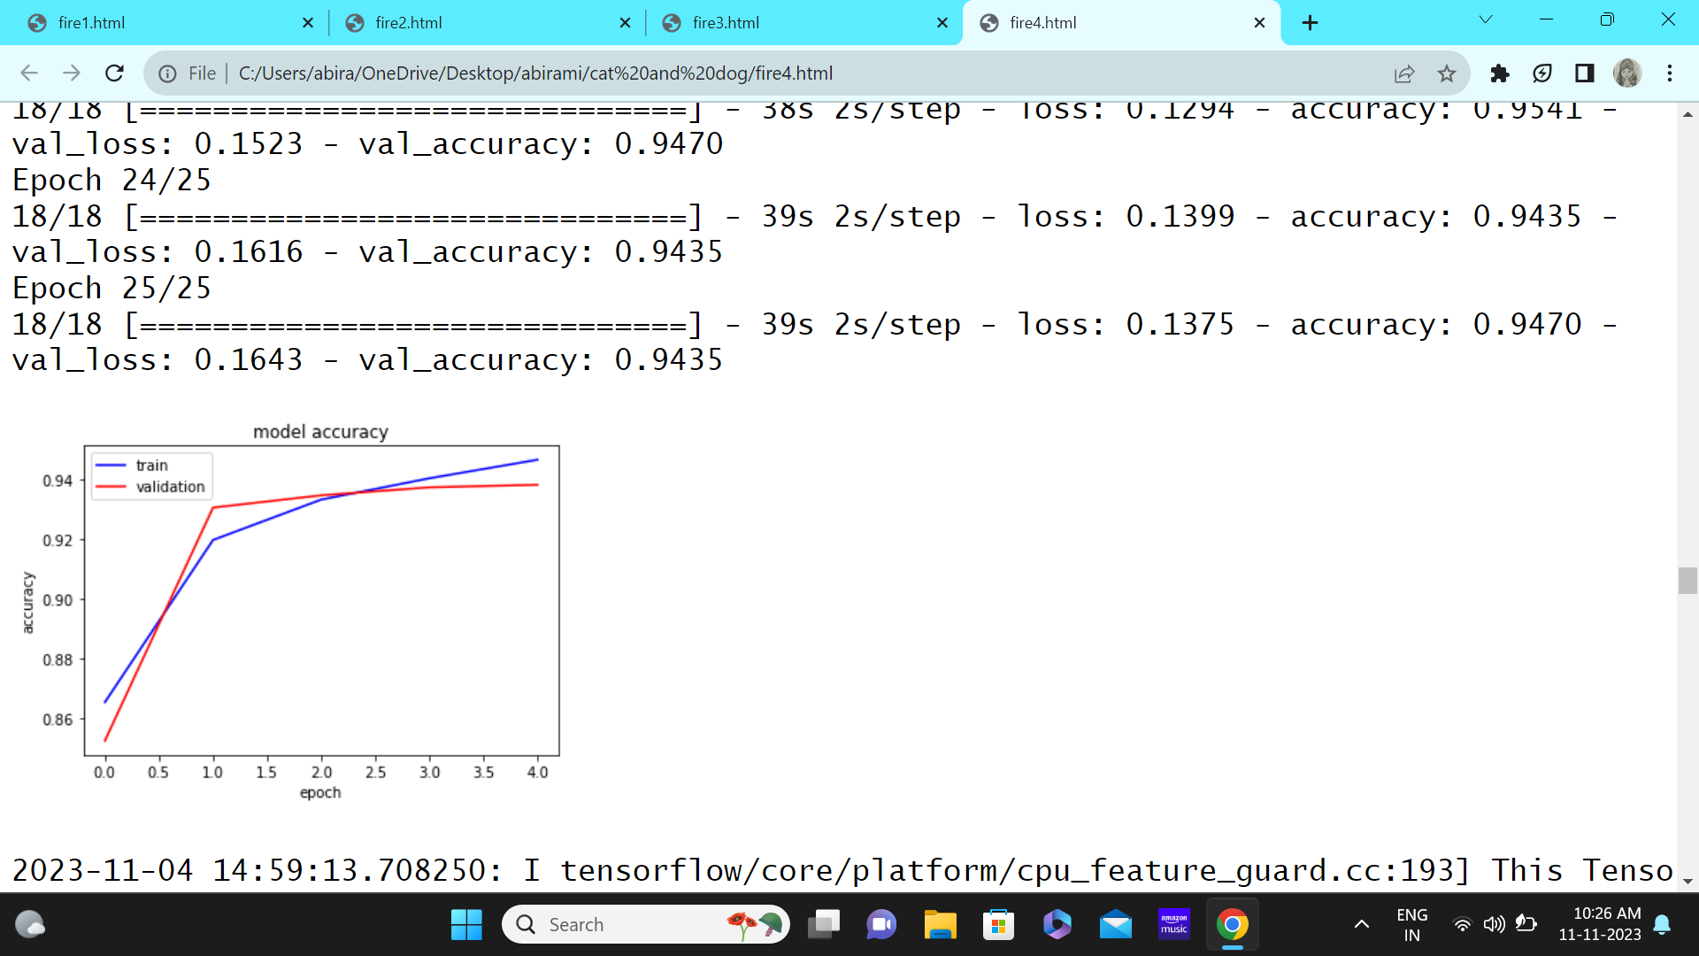
Epoch: 25; no kfold; optimizer: adam
Epoch: 25; kfold: 5; optimizer: adam
Epoch: 20; kfold: 5; optimizer: adam
Epoch: 25; kfold: 5; optimizer: SGD

Slide 4
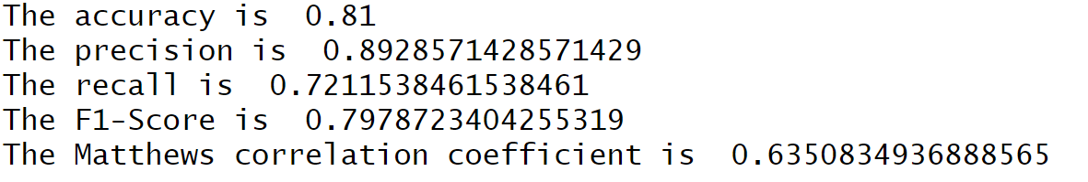
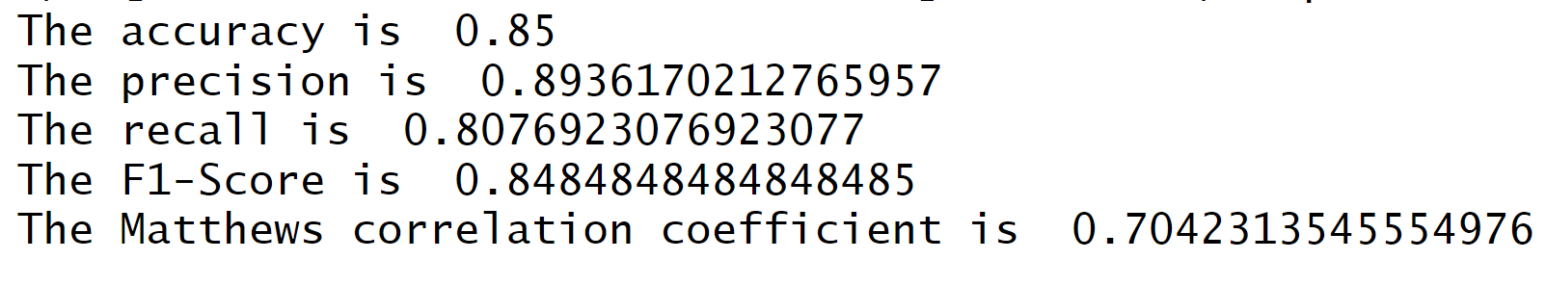
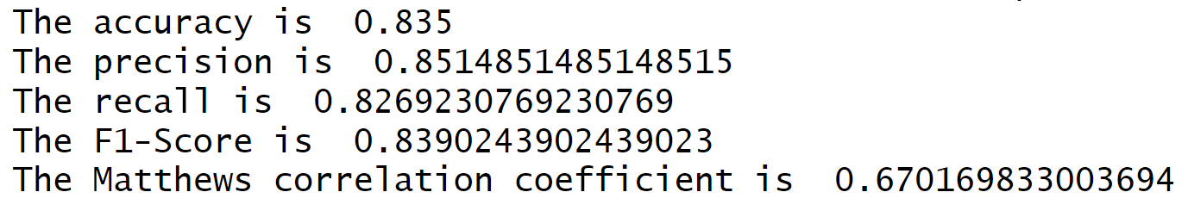
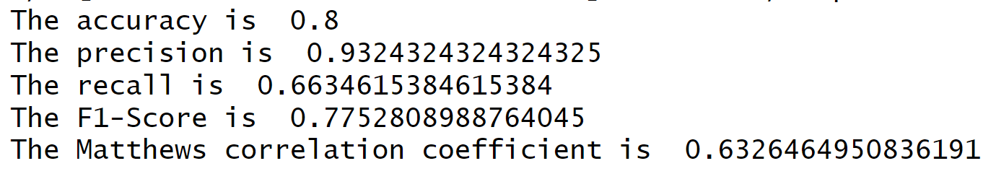
Epoch: 25; no kfold; optimizer: adam
Epoch: 20; kfold: 5; optimizer: adam
Epoch: 25; kfold: 5; optimizer: adam
Epoch: 25; kfold: 5; optimizer: SGD

